Slide 1


Image Warping
Chi Liu
Carnegie Mellon University
chil1@andrew.cmu.edu
2016.12.28
Loading……
Notes:
chil1@andrew.cmu.edu

Slide 2

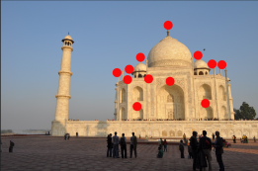

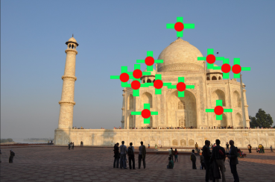
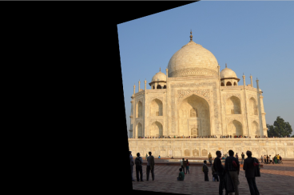


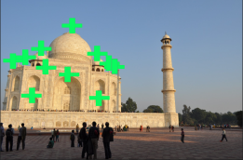



Homography estimation
Homography estimation
Constructing Panoramas
Detecting transparent object
taj1
Point1
taj2
Point2
SVD
Point2_T
Overlap
Select pair of points manually
taj2 warped into taj1
Original images
Homography estimation
Verify H
*
Notes:
Deformation 变形
In the field of computer vision, any two images of the same planar surface in space are related by a homography.
Camera rotation and translation can be extracted from an estimated homography matrix.

Slide 3
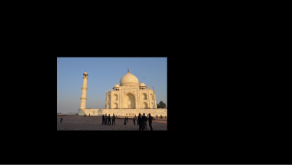
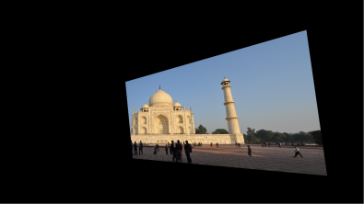
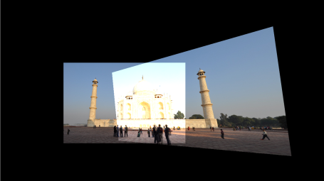

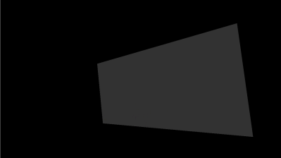

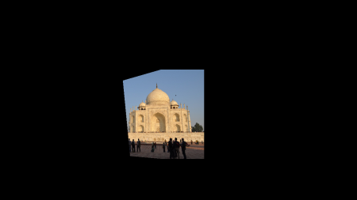
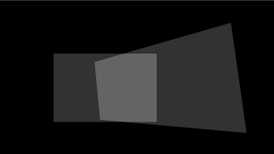
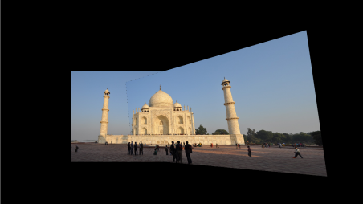
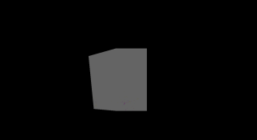
Constructing Panoramas
0
Homography estimation
Constructing Panoramas
Detecting transparent object
0
0
Panorama
with 2 overlaps
0
0
1
1
0
Overlap
Mask1
Mask2
0
1
2
1
Mask3
0
Panorama
0
2
Mask_overlapping
*
Notes:
warpH
Greater than 0
Dot product

Slide 4
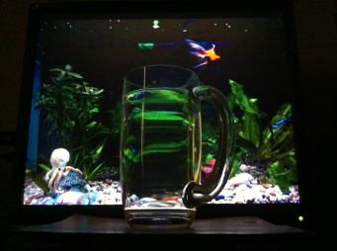
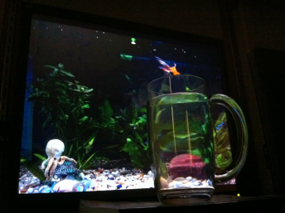
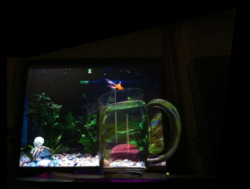
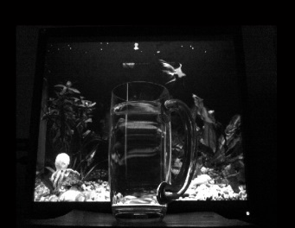
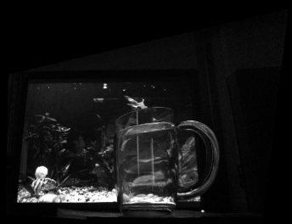
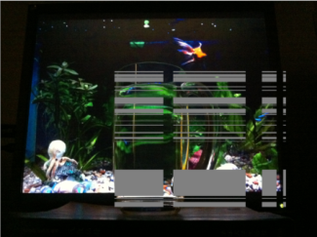
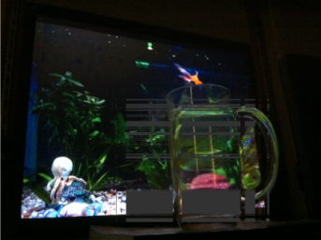
Detecting transparent object
Homography estimation
Constructing Panoramas
Detecting transparent object
Transparent Mask
> threshold
Gray_mug1
Gray_mug2
mug2 to mug1
mug1to mug2
*

Slide 5
THANKS
Chi Liu
Carnegie Mellon University
2016.12.28

